Slide 1

Data Analytics using Cloudera Hadoop
Dataset Used : Stocks.csv
Technologies Used : Cloudera Hadoop, HDFS, Map-Reduce, Hive, Sqoop, Spark using Scala

Slide 2
Contents & Introduction:
The Mini-Project consists of 4 sub-parts which uses different technologies.
Map-Reduce: Finding words present in different files
Sqoop Task: Loading Data from RDBMS to HDFS
Stocks Analysis using Hive
Twitter’s Top 10 popular Hashtag Streaming per second using Apache Spark

Slide 3
Objectives:
Map-Reduce: to find words or keywords present in how many files along with the file names
Sqoop: to load data from RDBMS (MySQL) to HDFS & then load data from HDFS to Hive tables
Stocks Analysis using Hive: to run Hive queries on the stocks dataset loaded using Sqoop and then perform analysis on it
Apache Spark: to find Top 10 popular Hashtag on Twitter and perform web scraping using Spark & Scala to stream the data on ‘per second’ basis

Slide 4

Part 1: Map-Reduce
What is Map-Reduce?
Two important Tasks: Map and Reduce
What Mapper do!
What Reducer do!
Advantages of Map-Reduce

Slide 5
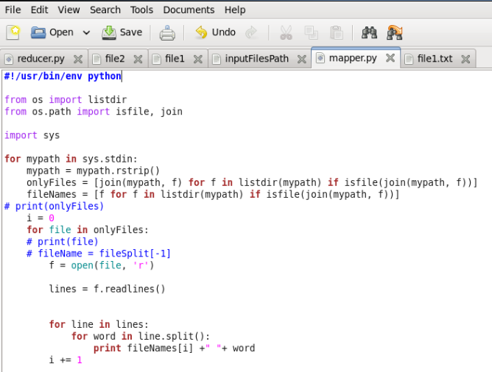
Project Task: To find words present in different files
Mapper.py

Slide 6
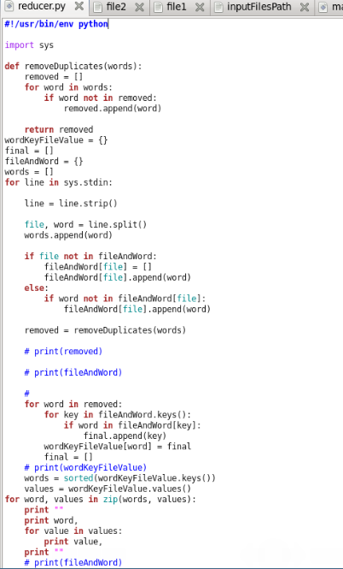
Reducer.py

Slide 7
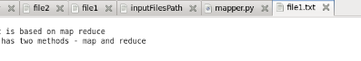
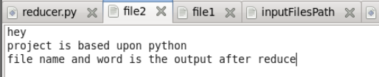
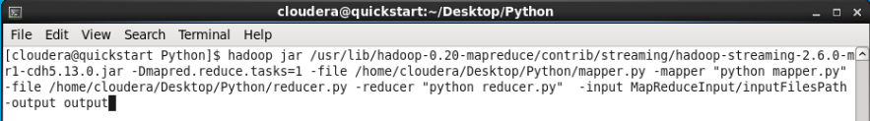
Files:
Command:

Slide 8
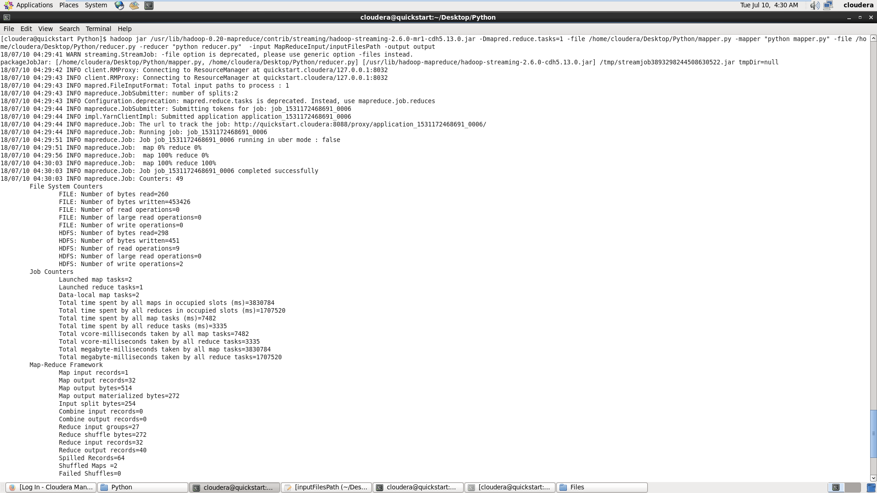
Command Execution:

Slide 9
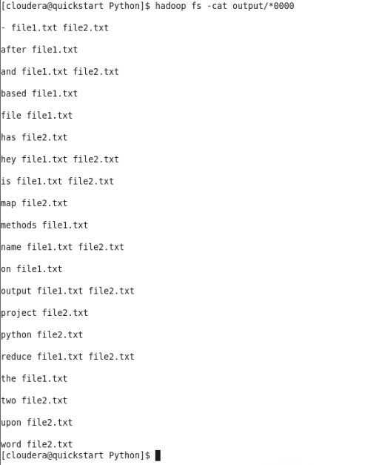
Output:

Slide 10
Conclusion and Takeaways:
Finds the words or keywords in specific files
What if the files are in millions?
Traditional methods will fail
Map-Reduce will work quite efficiently
Where it can be used?

Slide 11

Part 2: Sqoop
What is Sqoop?
Why Sqoop?
What is RDBMS and HDFS?
Dataset Used: Stocks.csv
Task: to load data from RDBMS (MySQL) to HDFS & then load data from HDFS to Hive tables

Slide 12
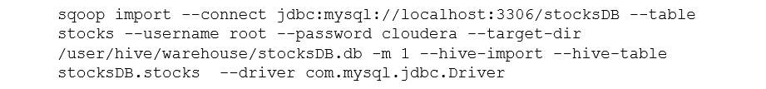
Command:
Command Breakdown:
Connect – Specify JDBC connect string
Table – Table to read from RDBMS
Username – Set authentication username
Password – Set authentication password
Target – HDFS destination directory
Hive-table – Sets the table name to use when importing to Hive.
Driver – Manually specify JDBC driver class to use

Slide 13
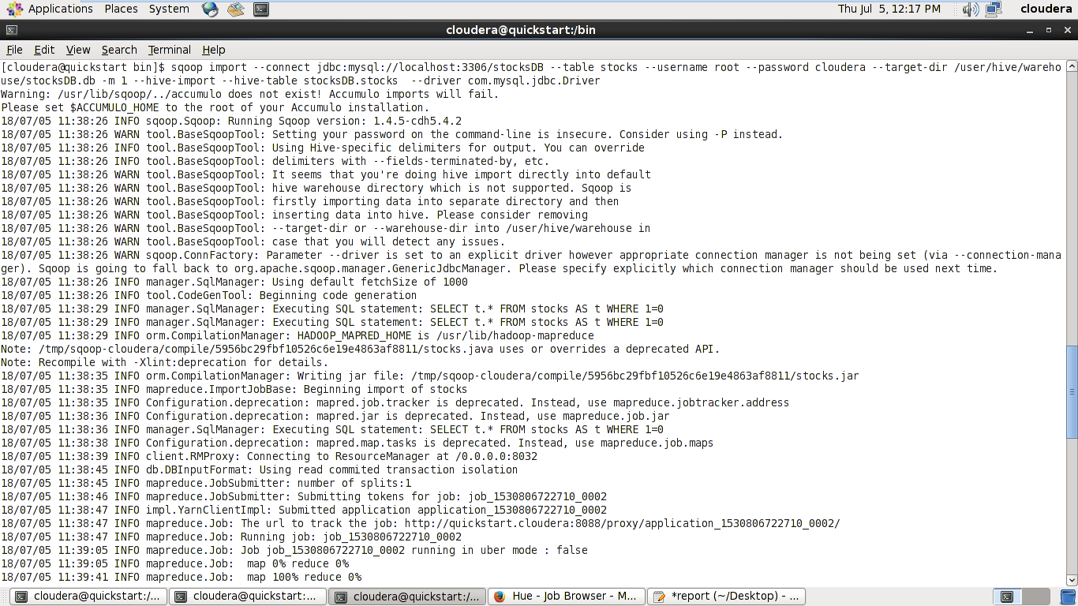
Command Execution:

Slide 14
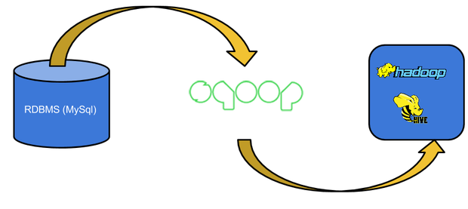
Map – 100%
Reduce – 100%
Data is now loaded into HDFS as Hive tables
Hive Analysis can now begin

Slide 15

Part 3: Hive
What is Hive?
Why Hive?
Advantages of Hive
Dataset Used: Stocks.csv
Task: to run Hive queries on the stocks dataset loaded using Sqoop to understand it better and then perform analytics on it.

Slide 16
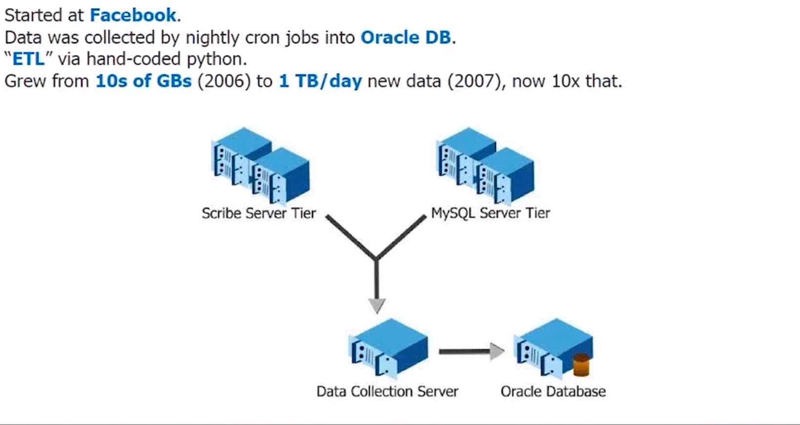
Hive Background

Slide 17
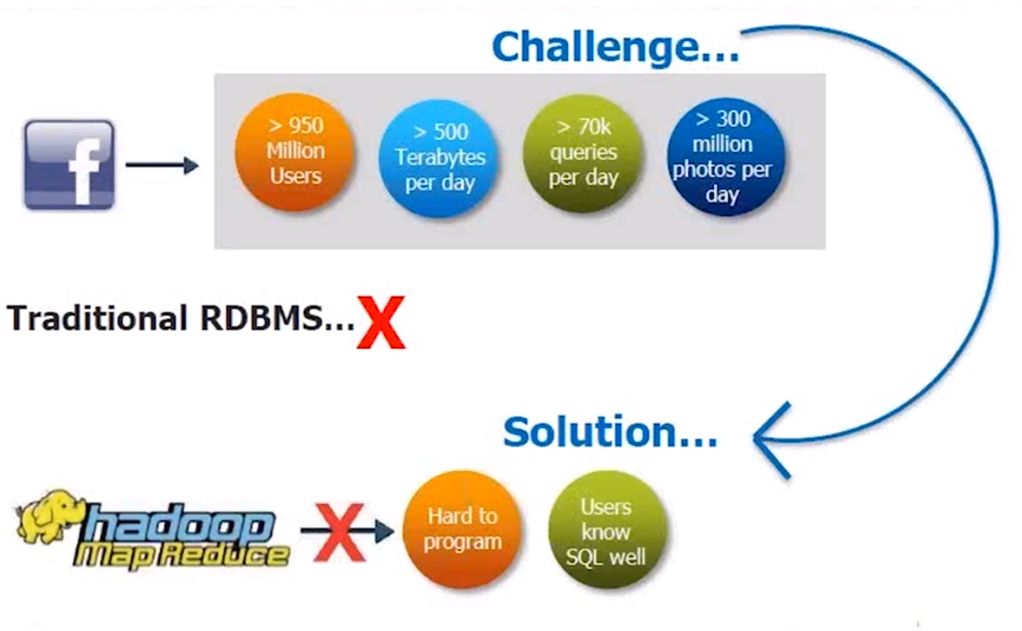
Use Case @ Facebook

Slide 18
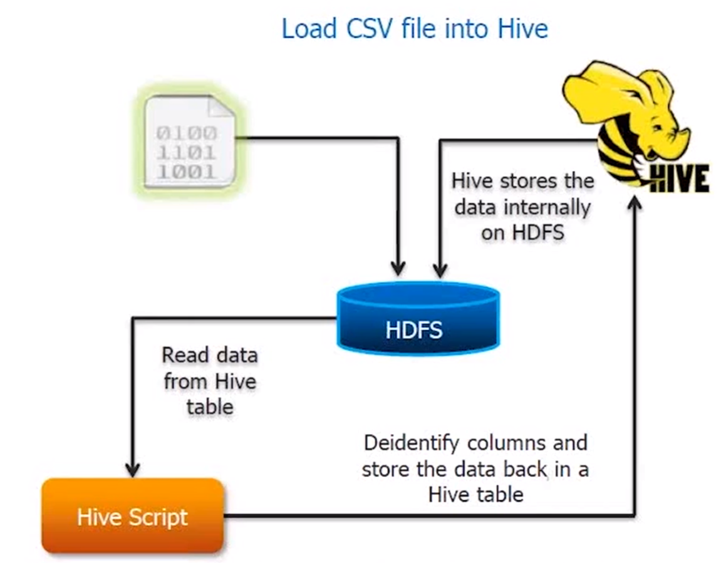
Functioning

Slide 19
Some intuition about dataset
Size - 40MB
Rows - 7,35,026
Columns - 9 different features

Slide 20
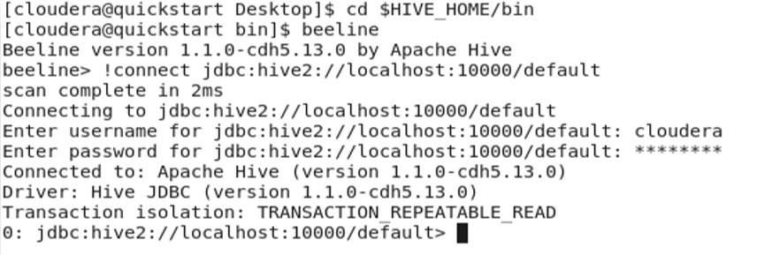
Basic Pre-requisites before Analyzing
Step 1 – Opening Hive2 / Thrift Server and making connection.

Slide 21
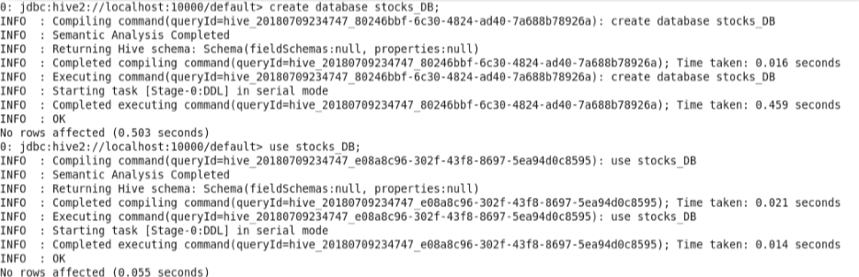
Basic Pre-requisites before Analyzing
Step 2 - Creating & using Database stocks_DB
Commands – 1. create database stocks_DB;
2. use stocks_DB;

Slide 22
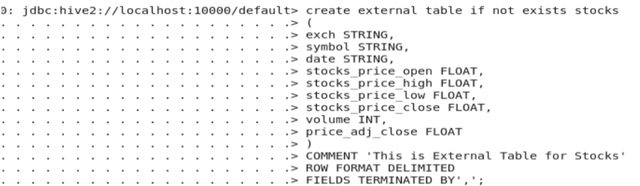
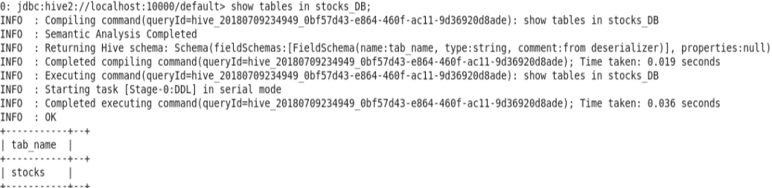
Basic Pre-requisites before Analyzing
Step 3 - Creating external stocks table

Slide 23
Stocks Analysis using Hive
Query 1 – Finding top 10 companies according to number of stocks
Command
SELECT symbol, count(symbol) as count from stocks group by symbol order by count DESC LIMIT 10;

Slide 24
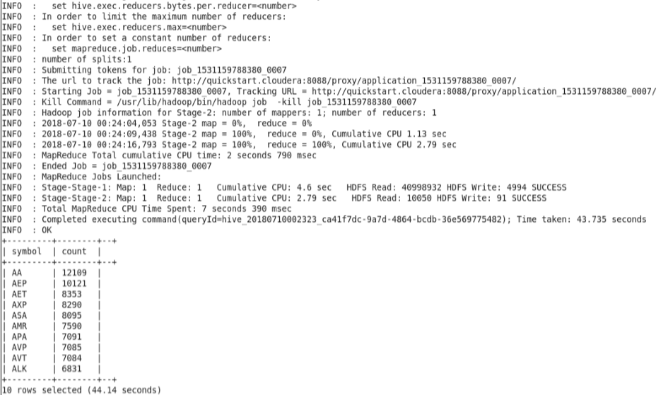
Conclusion / Output

Slide 25
Stocks Analysis using Hive
Query 2 – Finding top 10 month & year according to rise in stocks price
Command
SELECT month(date) as month, year(date) as year, (max(stocks_price_high) – min(stocks_price_low)) as stocksPriceRise from stocks group by month(date), year(date) order by stocksPriceRise DESC LIMIT 10;

Slide 26
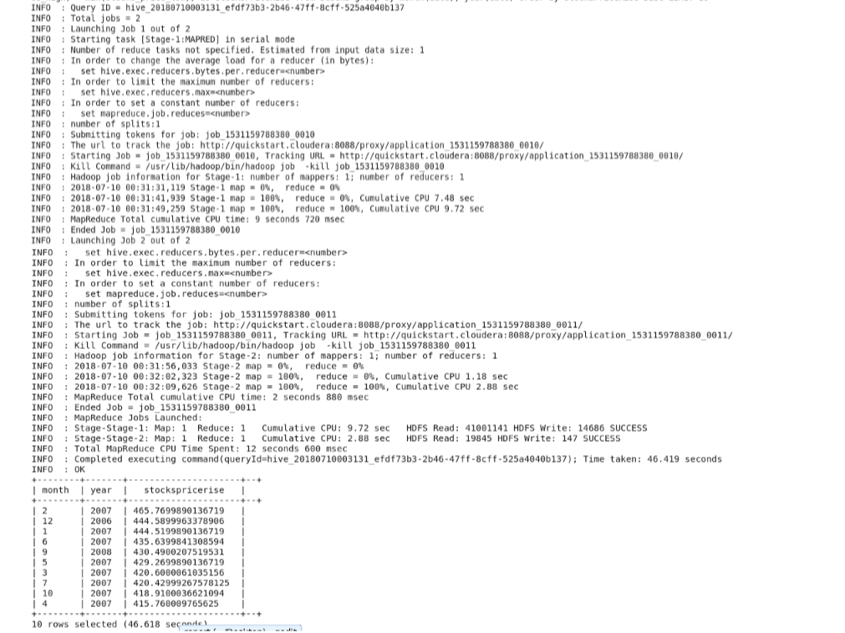
Conclusion / Output

Slide 27
Stocks Analysis using Hive
Query 3 – Finding top 10 max difference b/w stock price adjustment close and stock price close
Command
SELECT price_adj_close – stocks_price_close as adj from stocks order by adj DESC LIMIT 10;

Slide 28
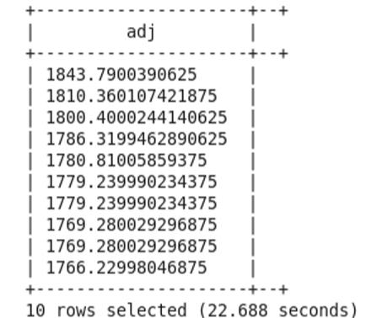
Conclusion / Output

Slide 29
Stocks Analysis using Hive
Query 4 – Finding top 10 companies according to volume of stocks
Command
SELECT symbol, max(volume) as MAXVOL from stocks group by symbol order by MAXVOL DESC LIMIT 10;

Slide 30
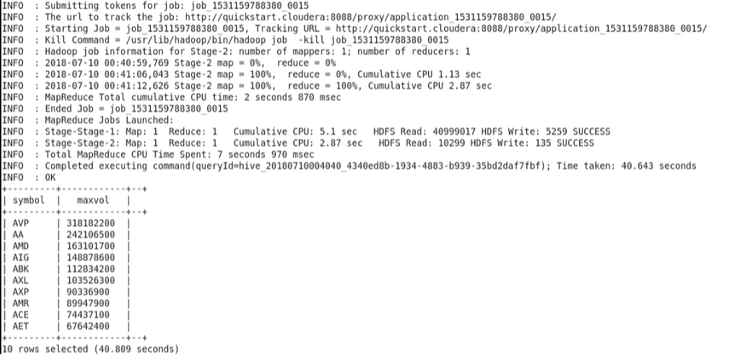
Conclusion / Output

Slide 31
Stocks Analysis using Hive
Query 5 – Finding top 10 dates according to number of stocks of company AVP
Command
SELECT date, volume from stocks where symbol = “AVP” order by volume DESC LIMIT 10;

Slide 32
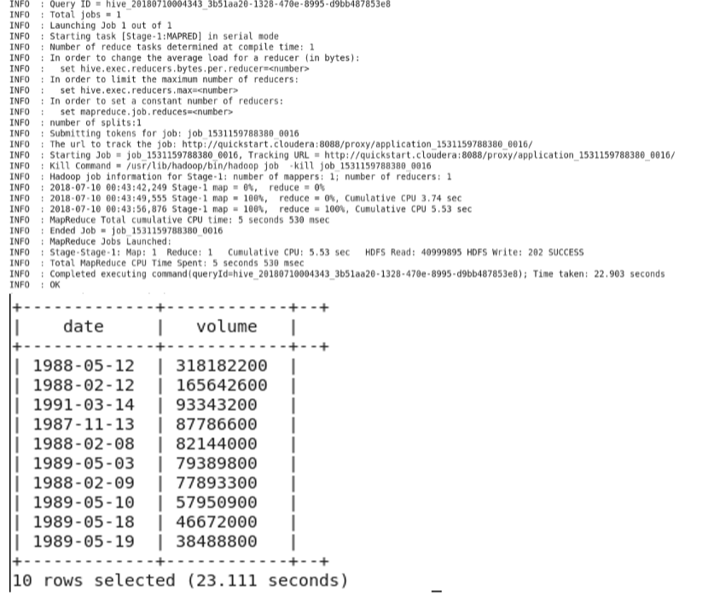
Conclusion / Output

Slide 33
Stocks Analysis using Hive
Query 6 – Finding maximum stock price in AVP company.
Command
SELECT MAX(stocks_price_high) as max_high FROM stocks_partition WHERE sym = ‘AVP’;

Slide 34
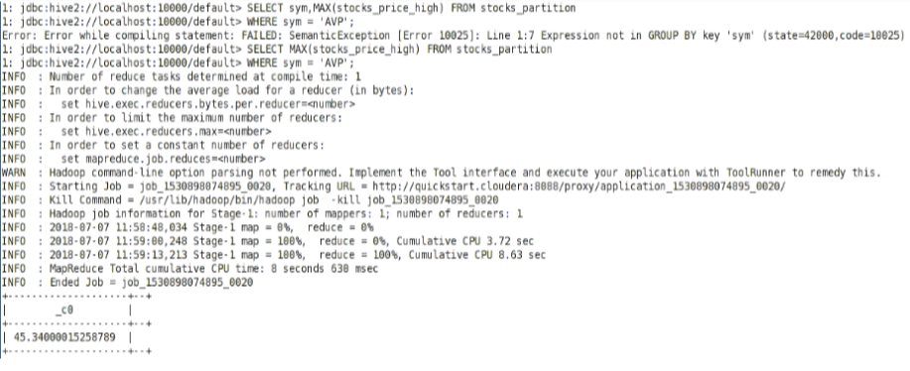
Conclusion / Output

Slide 35
Stocks Analysis using Hive
Query 7 – Finding top 10 years according to average volume of stocks
Command
SELECT year(date), avg(volume) as avgVol from stocks group by year(date) order by avgVol DESC LIMIT 10;

Slide 36
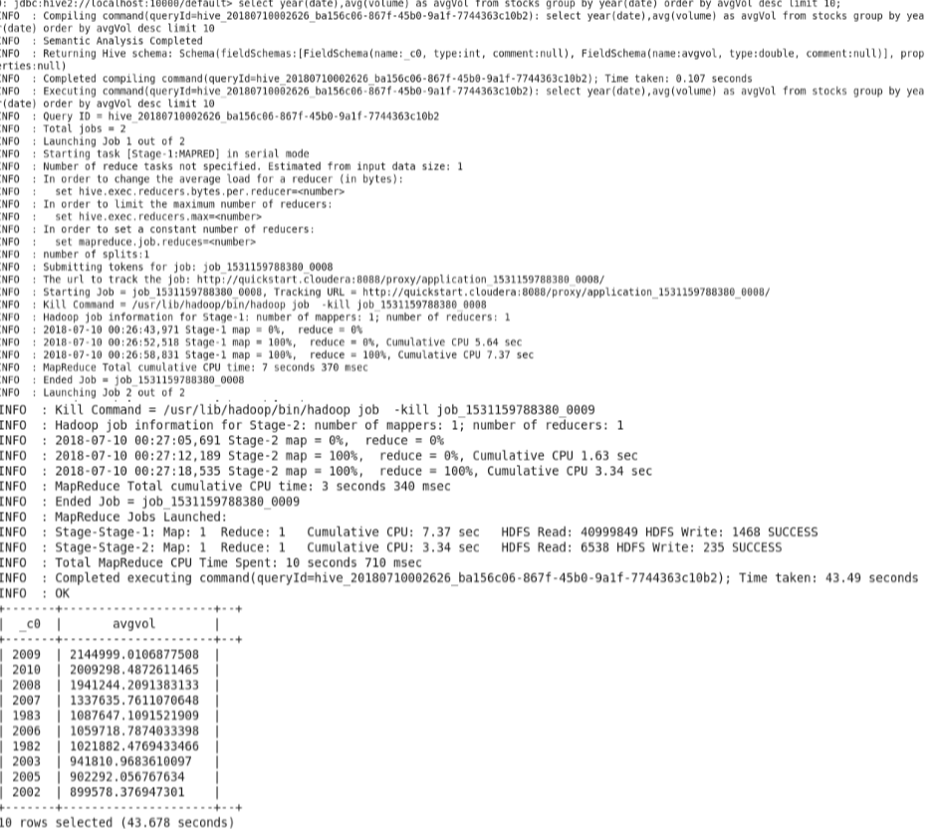
Conclusion / Output

Slide 37
Conclusion and Insights:
Descriptive analysis insights
Company AA has highest number of stocks i.e. 12109
Maximum rise in stocks price was in February, 2007
Maximum difference b/w stock price adjustment close and stock price close was 1843.79
Company AVP has highest volume of stocks i.e. 318182200
Highest number of stocks of company AVP was on 12th of May, 1998
Maximum stock price of AVP company was 45.34
Average volume of stocks sold were highest in 2009

Slide 38
Part 4: Spark Application
Top 10 Hashtags from twitter
real-time streaming

Slide 39

Data generated every minute

Slide 40

Need of Spark when we had Map-Reduce
Spark on Fire: Why all the hype?
How can we implement Spark?
Advantages of Spark
Data Used: Twitter’s Real-Time streaming data
Task: to find Top 10 popular Hashtag on Twitter and perform Web Scraping using Spark & Scala to stream the data on per second basis.

Slide 41
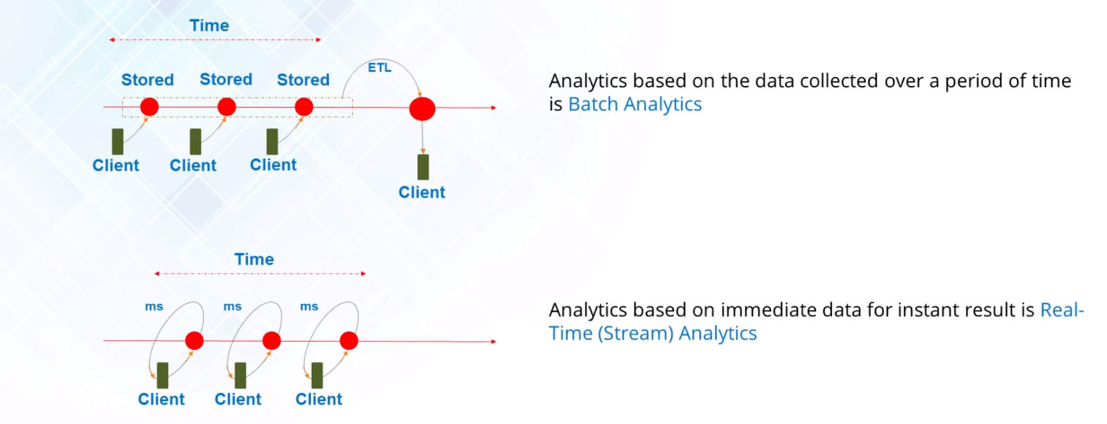
Batch / Real-time Processing

Slide 42
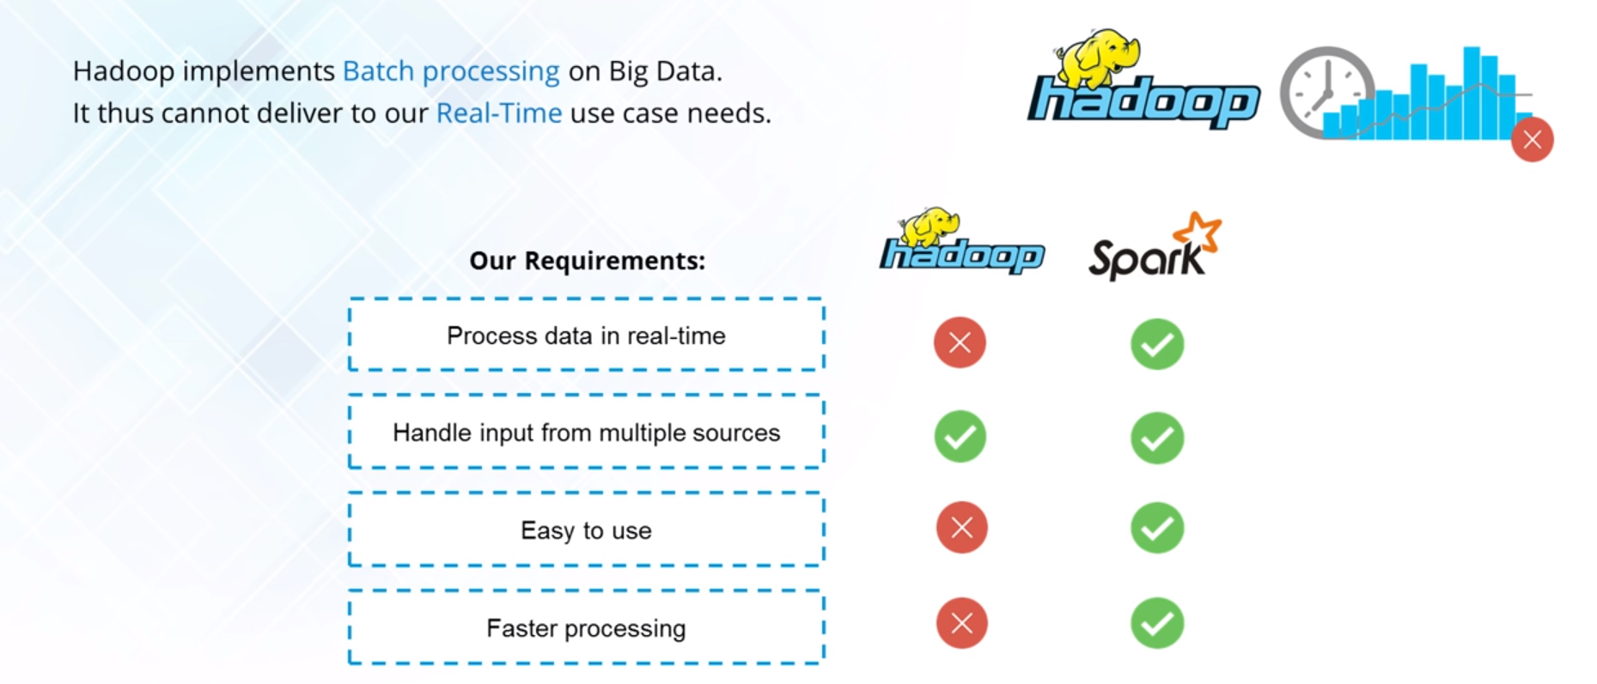
Spark v/s Hadoop

Slide 43
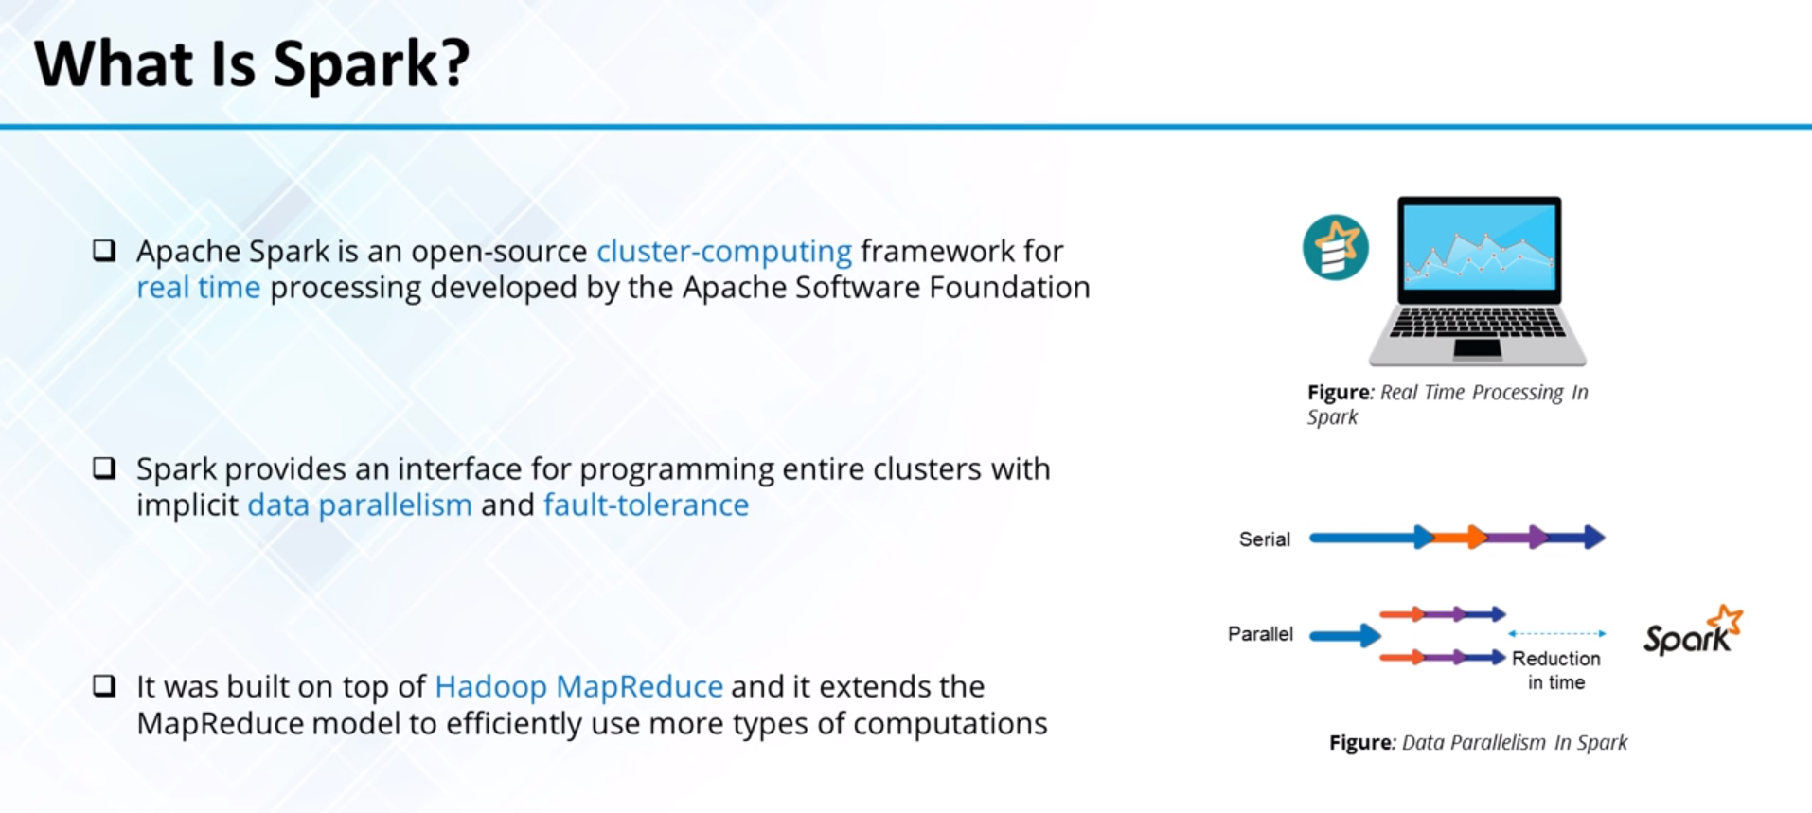

Slide 44
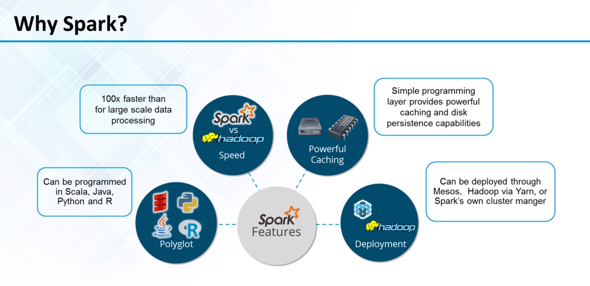

Slide 45
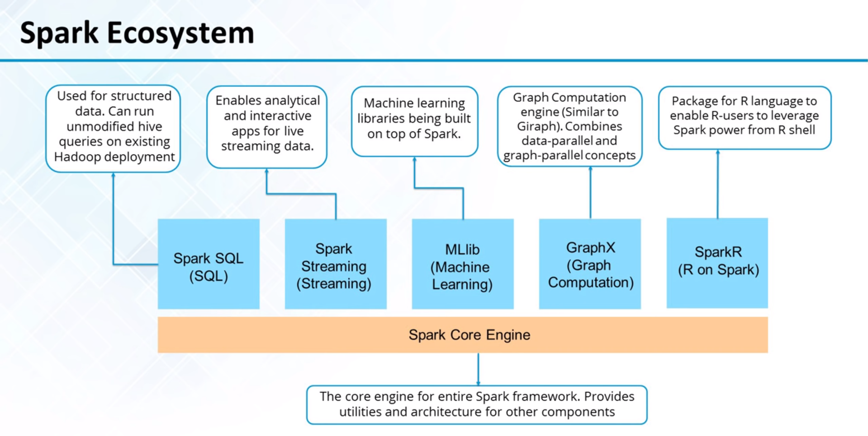

Slide 46

Spark success story

Slide 47
Twitter’s Top 10 popular Hashtag Streaming per second using Apache Spark
Technologies used –
Spark
Scala 2.11.11
Eclipse Scala IDE
Libraries used : dsstream-twitter_2.11-0.1.0-SNAPSHOT, twitter4j- core4.0.4, twitter4j-stream-4.0.4

Slide 48
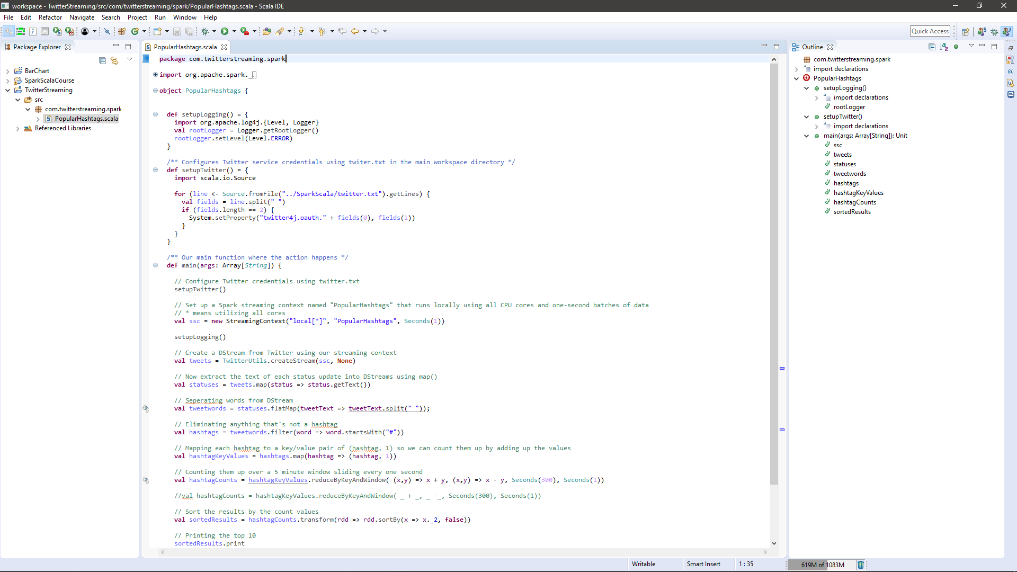
Scala and Spark Code:

Slide 49
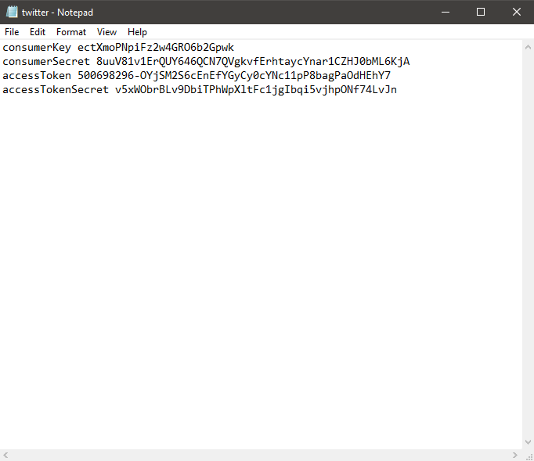
twitter.txt

Slide 50
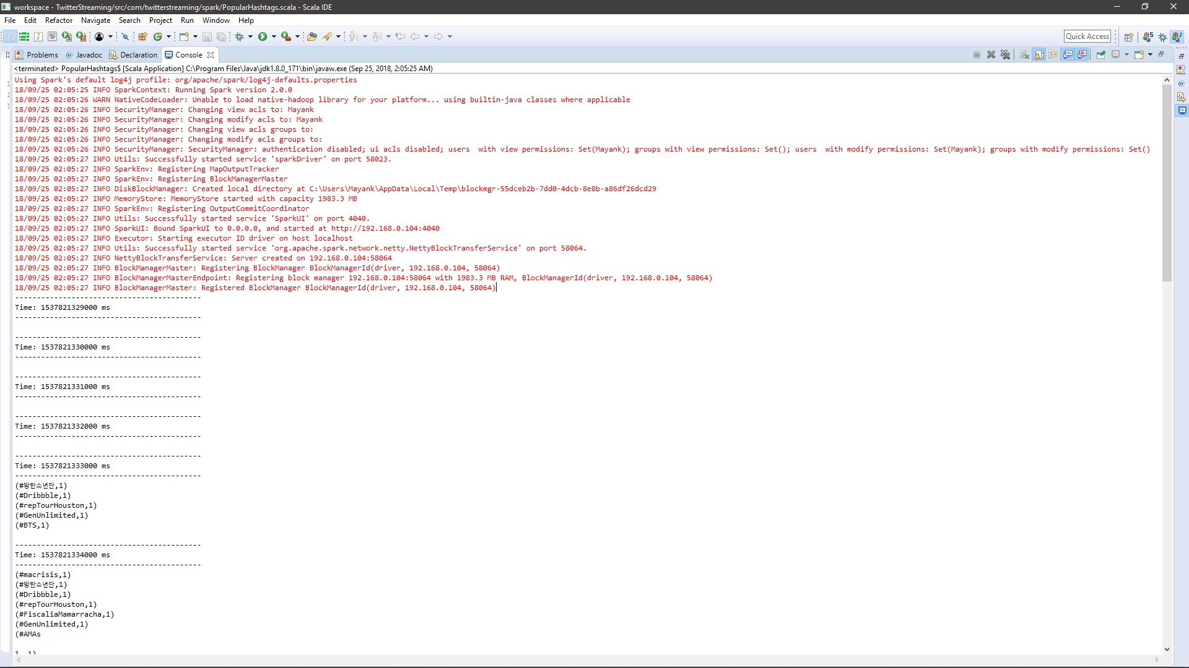
After Running Code:

Slide 51
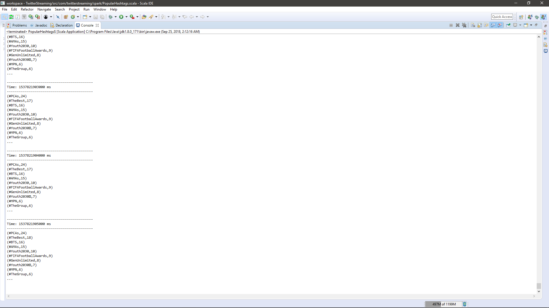
Conclusion:

Slide 52
Conclusion and Takeaways:
Analysis on Real-time Streaming data
Faster than Map-Reduce
Can be integrated with other databases
Where it can be used?

Slide 53
Part 5: Use Case: Earthquake Detection

Slide 54
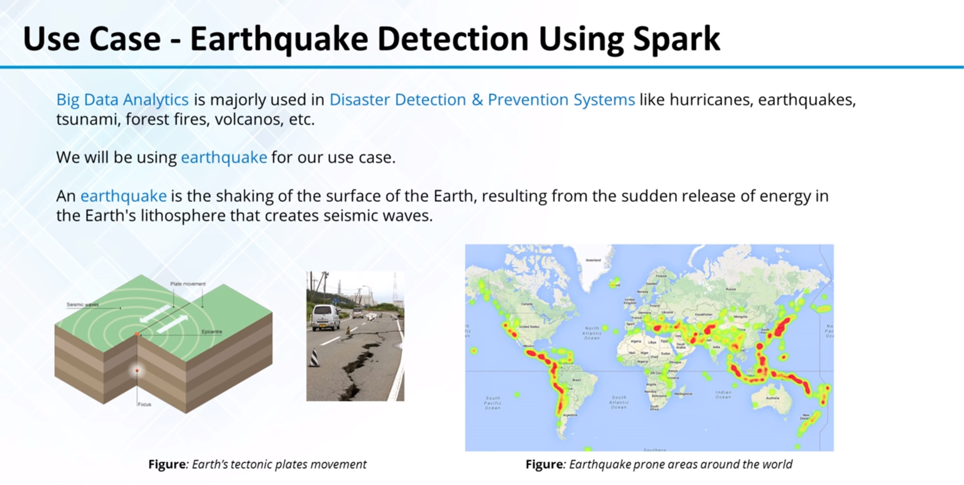
Spark success story

Slide 55
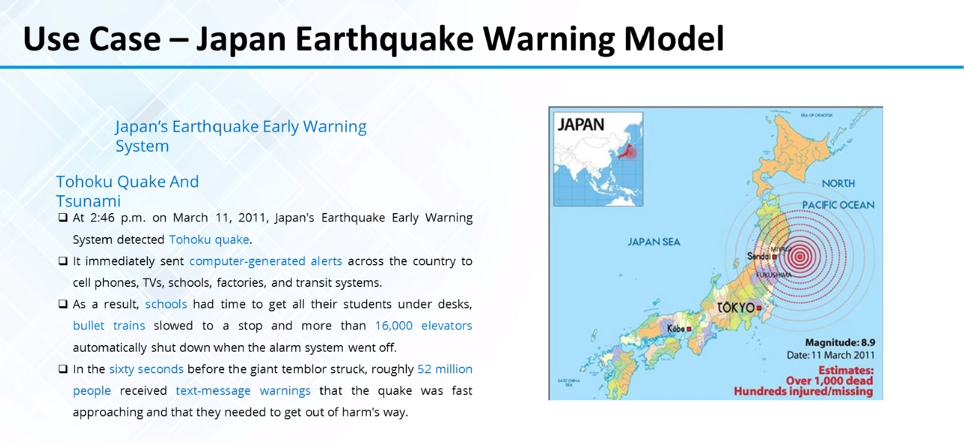

Slide 56
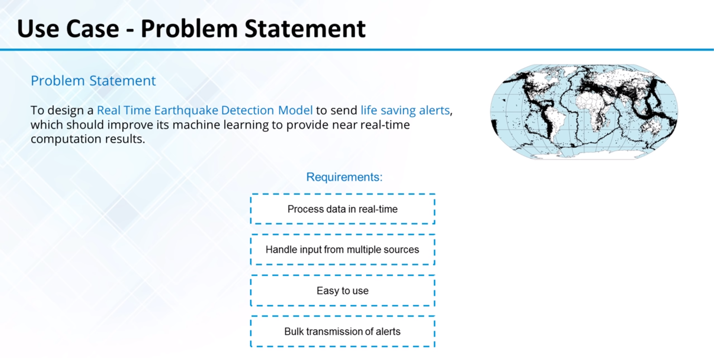

Slide 57
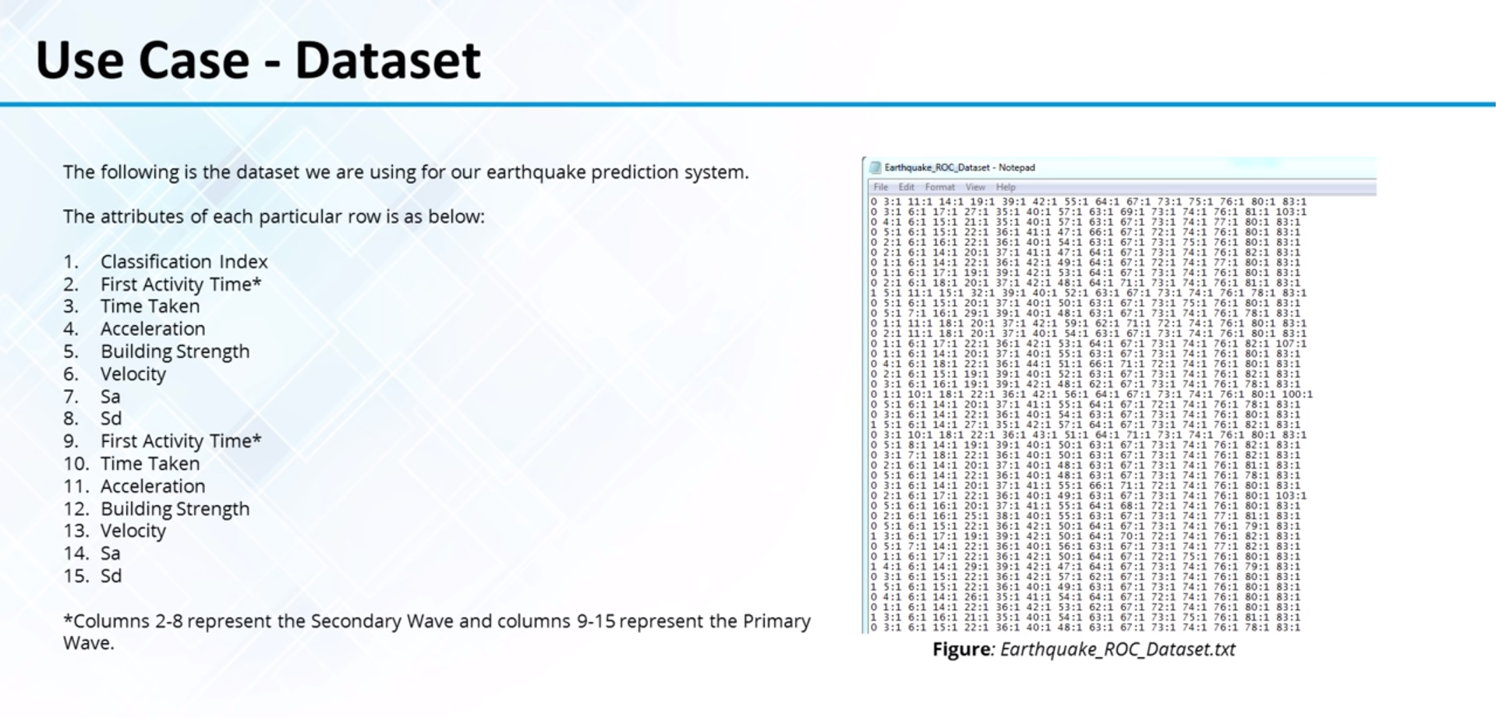

Slide 58
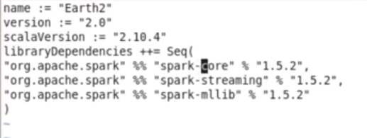
Dependencies:

Slide 59
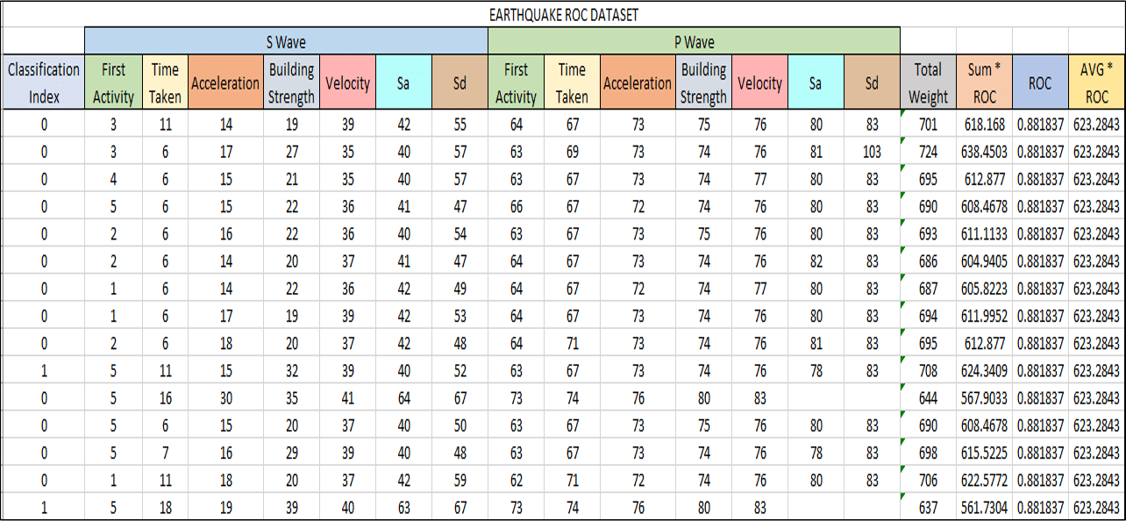
Dataset:

Slide 60
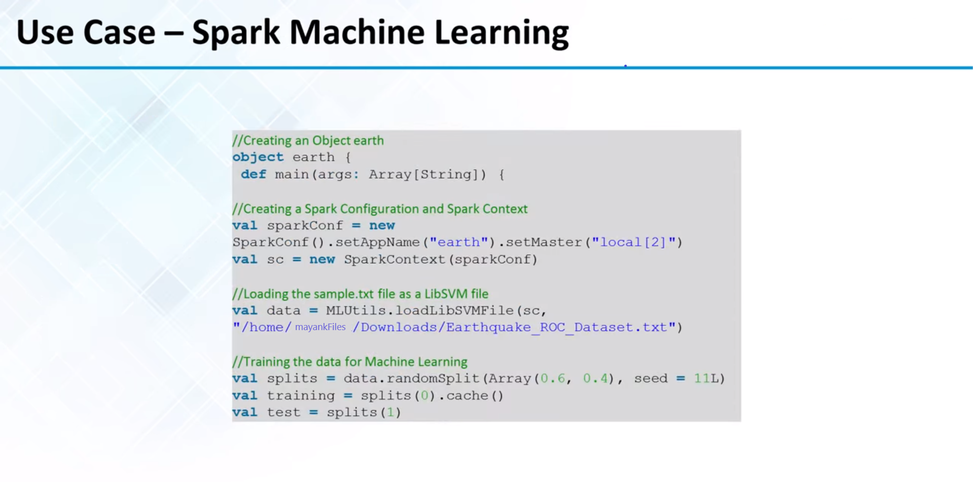

Slide 61
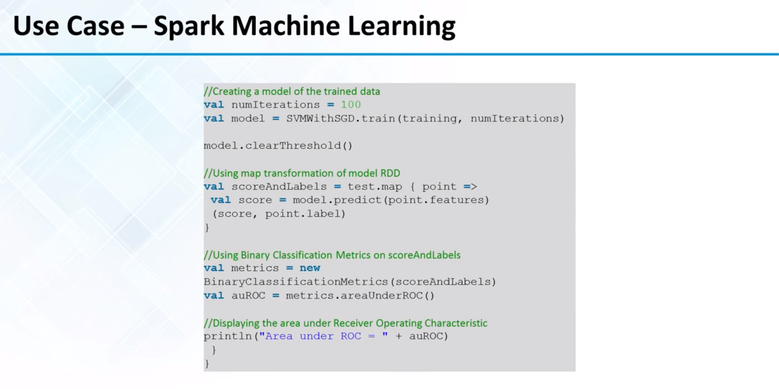

Slide 62
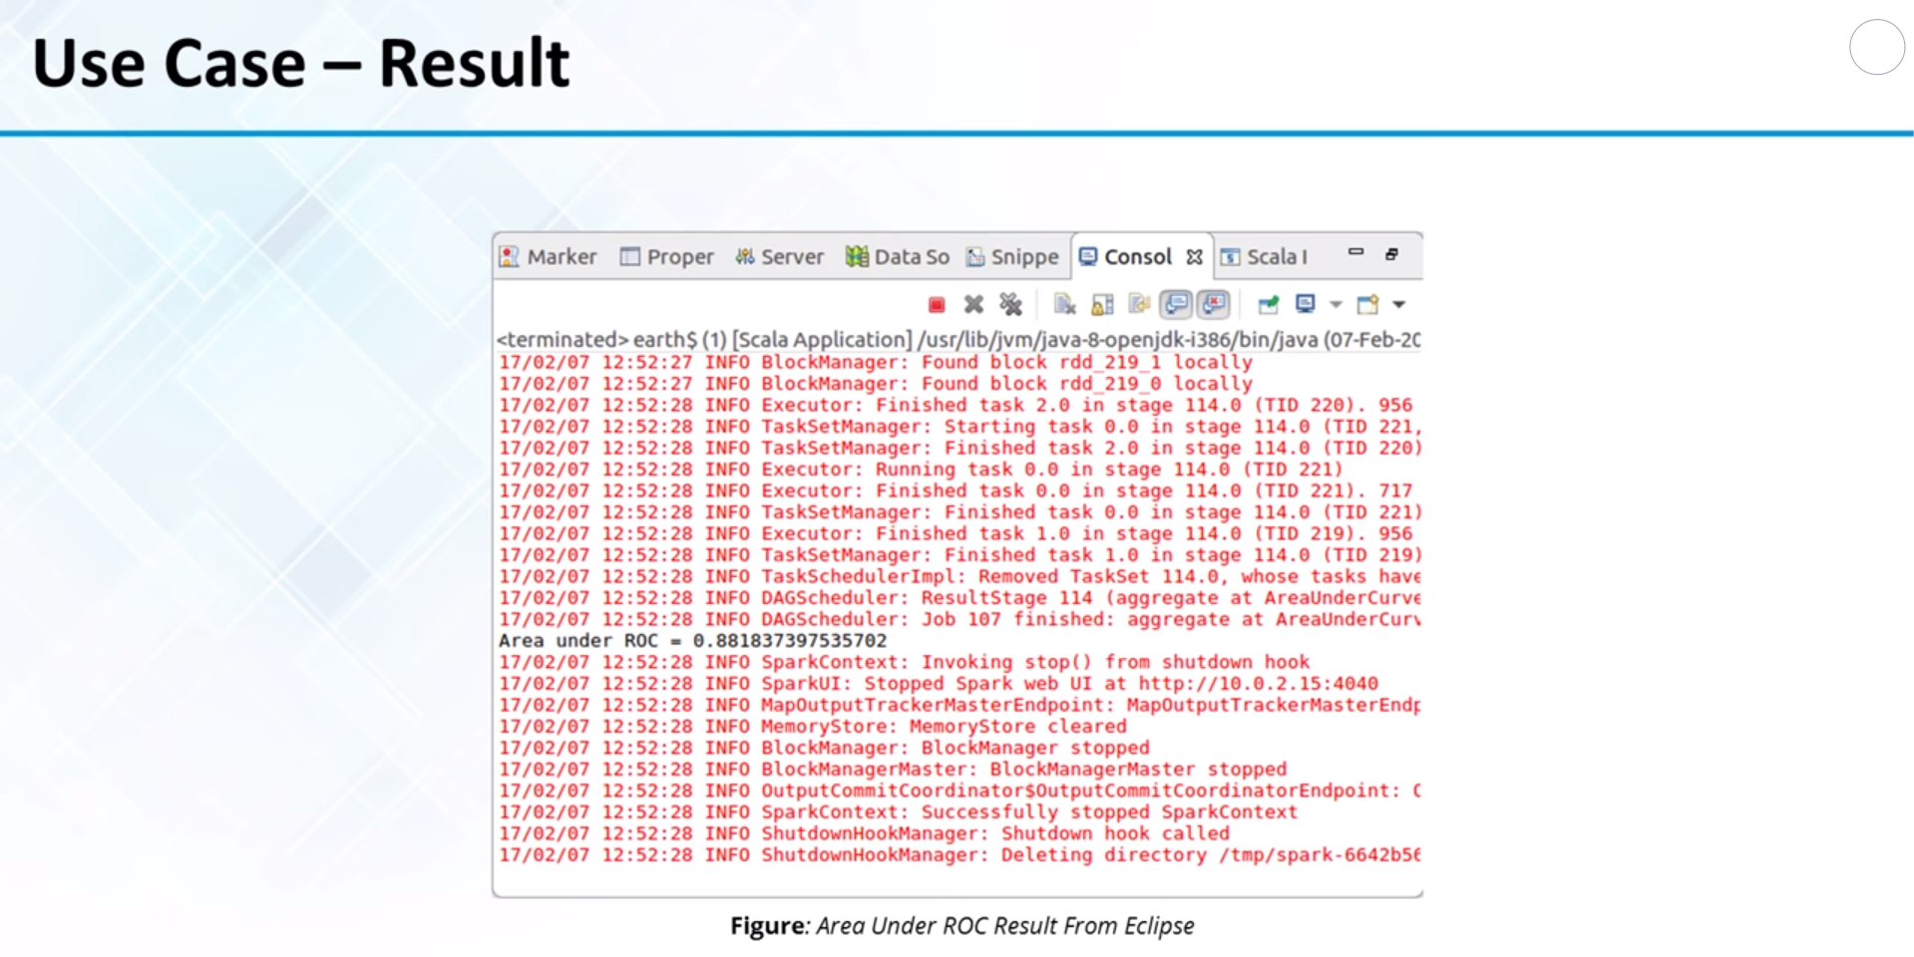

Slide 63
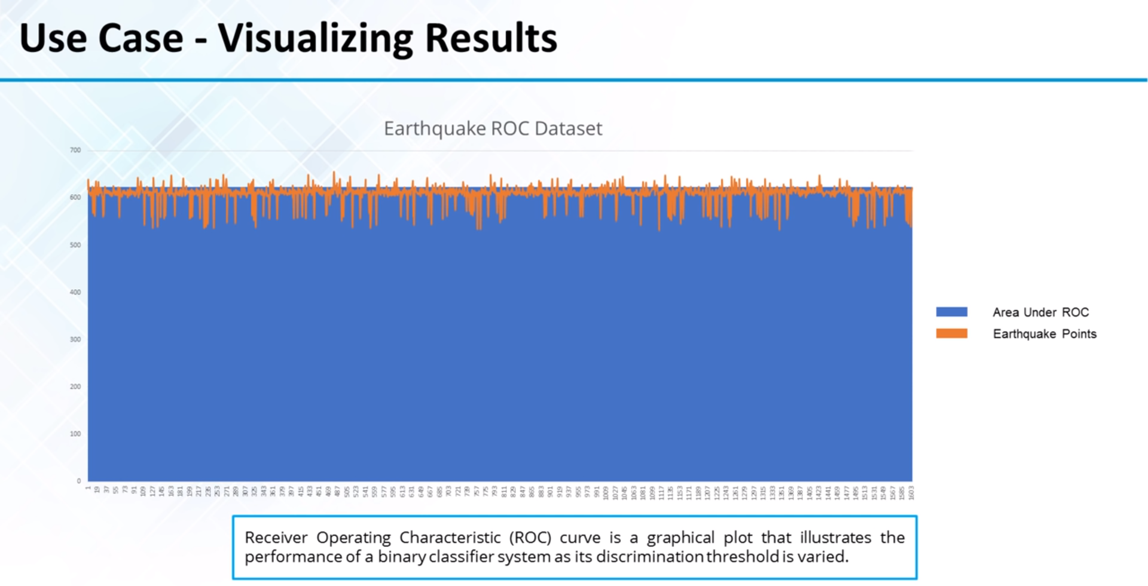

Slide 64
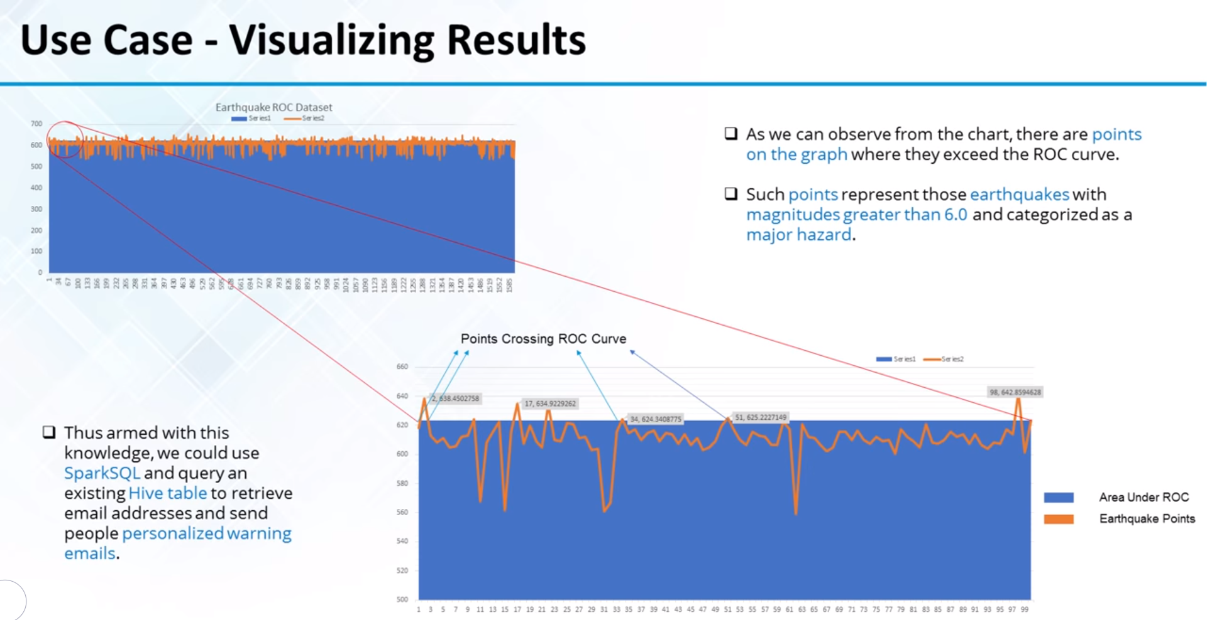

Slide 65
Thank You.

